Slide 1
Adversarial search (Min-Max procedure, Alpha-beta pruning)
(Based on slides of Mausam, Padhraic Smyth, Stuart Russell, Rao Kambhampati, Raj Rao, Dan Weld, Luigi Ceccaroni …)

Slide 2
Game Playing
Why do AI researchers study game playing?
It’s a good reasoning problem, formal and nontrivial.
Direct comparison with humans and other computer
programs is easy.

Slide 3
What Kinds of Games?
Mainly games of strategy with the following characteristics:
Sequence of moves to play
Rules that specify possible moves
Rules that specify a payment for each move
Objective is to maximize your payment

Slide 4
Games vs. Search Problems
Unpredictable opponent → specifying a move for every possible opponent reply
Time limits → unlikely to find goal, must approximate

Slide 5
Two-Player Game
Opponent’s Move
Generate New Position
Game
Over?
yes
no
Generate Successors
Evaluate Successors
Move to Highest-Valued Successor
no
Game
Over?
yes

Slide 6
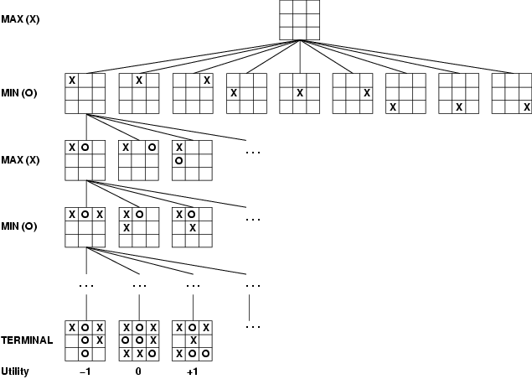
Game Tree (2-player, Deterministic, Turns)
computer’s
turn
opponent’s
turn
computer’s
turn
opponent’s
turn
leaf nodes
are evaluated
The computer is Max.
The opponent is Min.
At the leaf nodes, the
utility function
is employed. Big value
means good, small is bad.

Slide 7
Mini-Max Terminology
utility function: the function applied to leaf nodes
backed-up value
of a max-position: the value of its largest successor
of a min-position: the value of its smallest successor
minimax procedure: search down several levels; at the bottom level apply the utility function, back-up values all the way up to the root node, and that node selects the move.

Slide 8
Search with an opponent
Heuristic approximation: defining an evaluation function which indicates how close a state is from a winning (or losing) move
This function includes domain information.
It does not represent a cost or a distance in steps.
Conventionally:
A winning move is represented by the value“+∞”.
A losing move is represented by the value “-∞”.
The algorithm searches with limited depth.
Each new decision implies repeating part of the search.

Slide 9
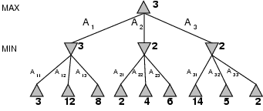
Minimax
Perfect play for deterministic games
Idea: choose move to position with highest minimax value = best achievable payoff against best play
E.g., 2-ply game:
Minimax-value(n): utility for MAX of being in state n, assuming both players are playing optimally =
Utility(n), if n is a terminal state
max_{s ∈ Successors(n)} Minimax-value(s), if n is a MAX state
min_{s ∈ Successors(n)} Minimax-value(s), if n is a MIN state

Slide 10
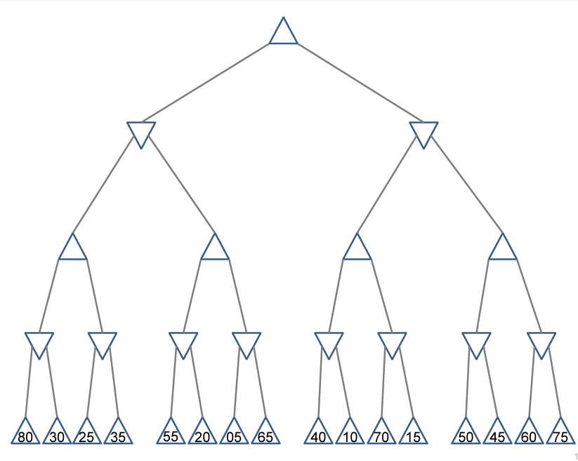

Slide 11
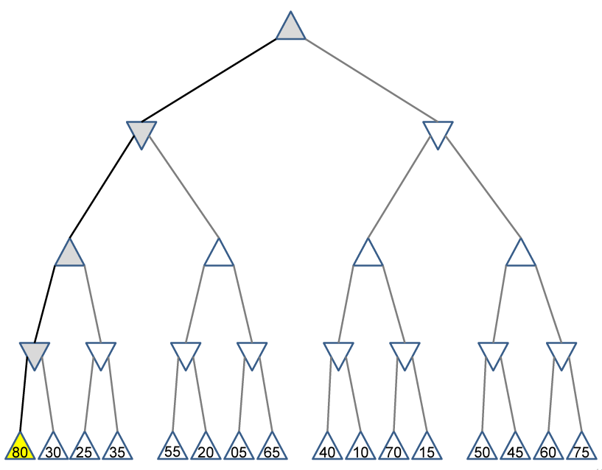

Slide 12
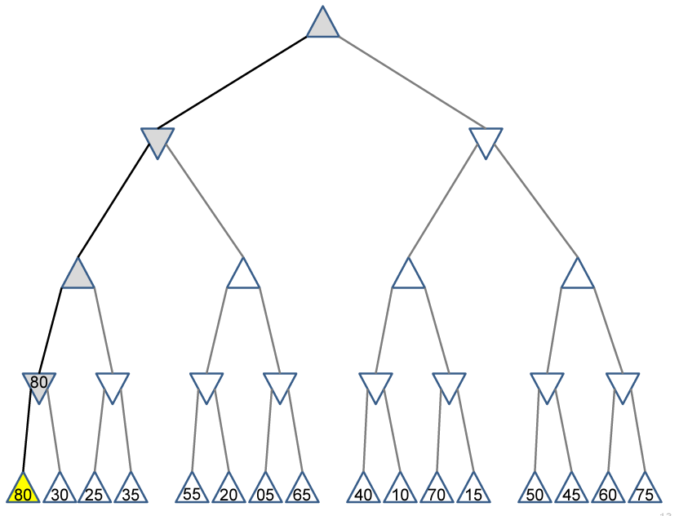

Slide 13
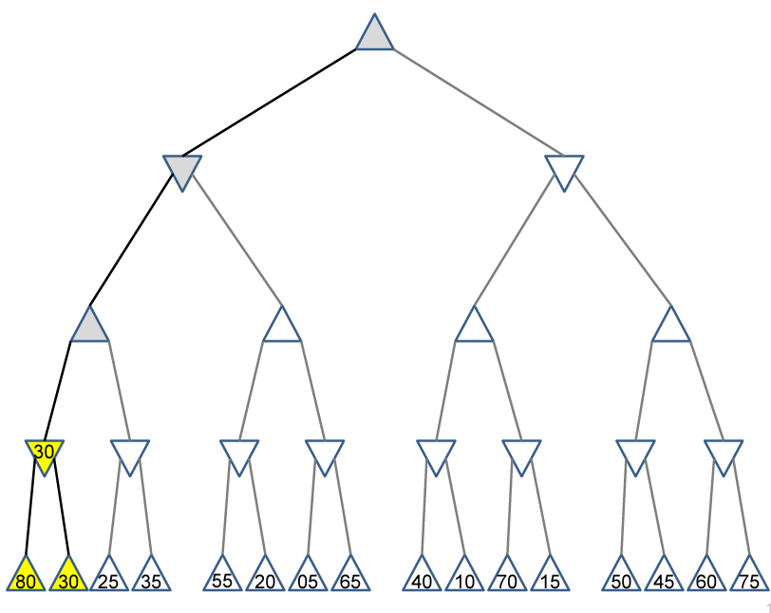

Slide 14
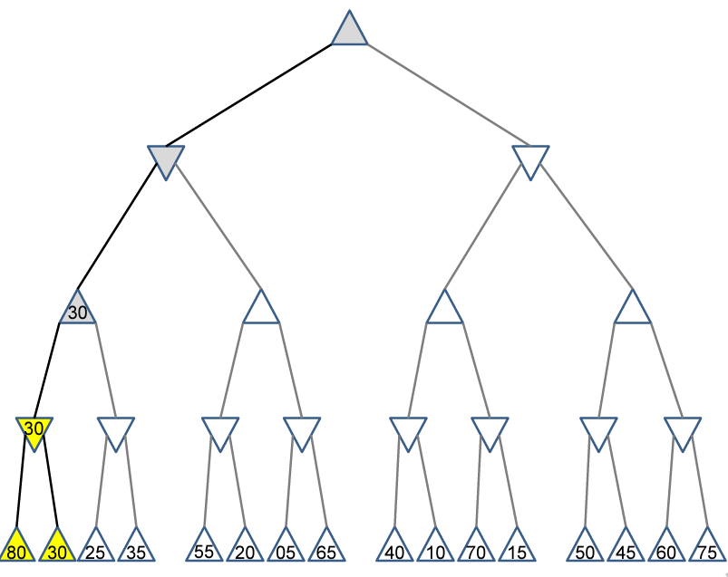

Slide 15
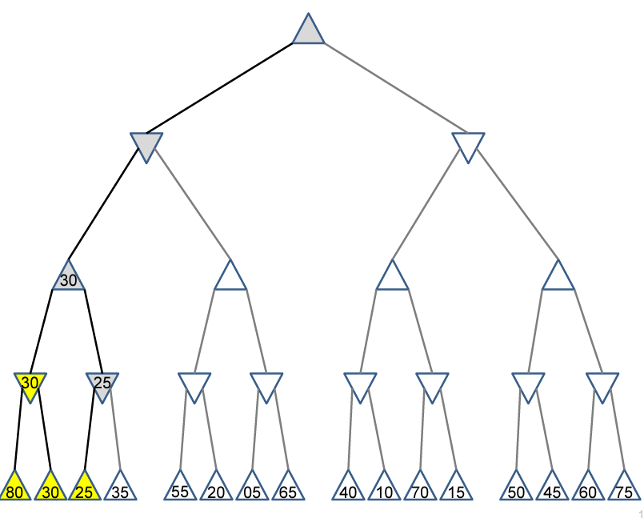

Slide 16
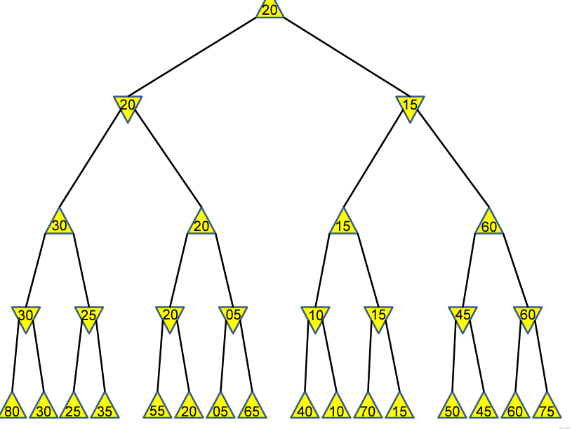

Slide 17
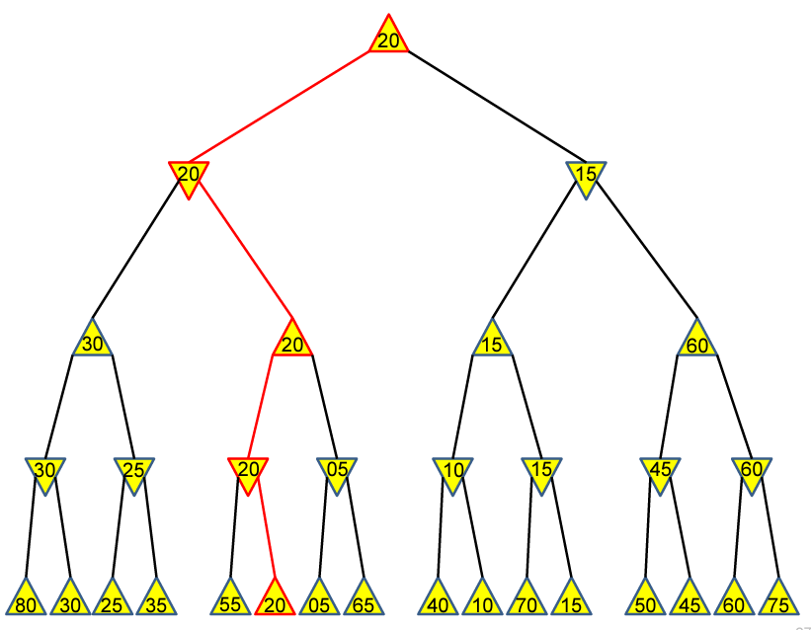

Slide 18
Minimax Strategy
Why do we take the min value every other level of the tree?
These nodes represent the opponent’s choice of move.
The computer assumes that the human will choose that move that is of least value to the computer.

Slide 19
The minimax Strategy
The minimax algorithm computes the minimax decision from the current state.
It uses a simple recursive computation of the minimax values of each successor state:
directly implementing the defining equations.
The recursion proceeds all the way down to the leaves of the tree.
Then the minimax values are backed up through the tree as the recursion unwinds.
19

Slide 20
The minimax algorithm
The minimax algorithm performs a complete depth-first exploration of the game tree.
In minimax, at each point in the process, only the nodes along a path of the tree are considered and kept in memory.
20

Slide 21
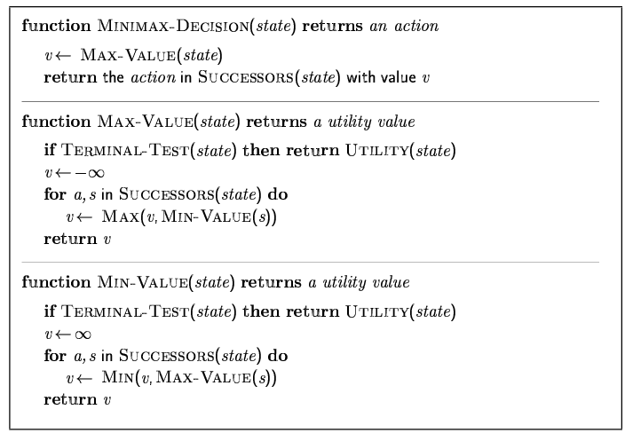
Minimax algorithm

Slide 22
The minimax algorithm Analysis
The minimax algorithm performs a complete depth-first exploration of the game tree.
In minimax, at each point in the process, only the nodes along a path of the tree are considered and kept in memory.
22

Slide 23
Example: tic-tac-toe
e (evaluation function → integer) = number of available rows, columns, diagonals for MAX - number of available rows, columns, diagonals for MIN
MAX plays with “X” and desires maximizing e.
MIN plays with “0” and desires minimizing e.
Symmetries are taken into account.
A depth limit is used (2, in the example).

Slide 24
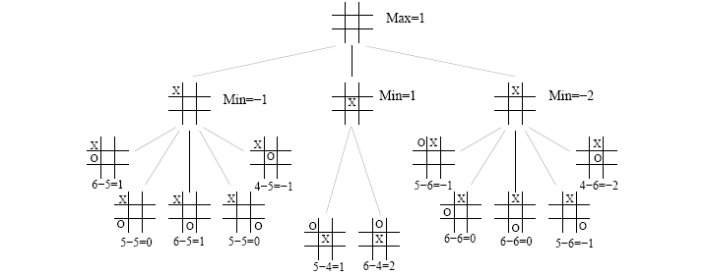
Example: tic-tac-toe

Slide 25
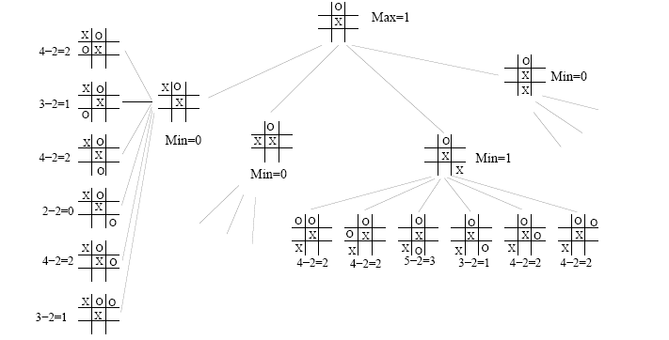
Example: tic-tac-toe

Slide 26
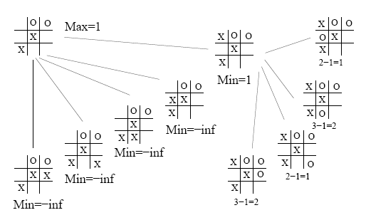
Example: tic-tac-toe

Slide 27
The minimax algorithm: problems
For real games the time cost of minimax is totally impractical, but this algorithm serves as the basis:
for the mathematical analysis of games and
for more practical algorithms
Problem with minimax search:
The number of game states it has to examine is exponential in the number of moves.
Unfortunately, the exponent can’t be eliminated, but it can be cut in half.
27

Slide 28
The minimax algorithm
If the maximum depth of the tree is m, and there are b legal moves at each point, then the time complexity is O(b^{m}).
The space complexity is:
O(bm) for an algorithm that generates all successors at once
O(m) if it generates successors one at a time.
28

Slide 29
The minimax algorithm: problems
For real games the time cost of minimax is totally impractical, but this algorithm serves as the basis:
for the mathematical analysis of games and
for more practical algorithms
Problem with minimax search:
The number of game states it has to examine is exponential in the number of moves.
Unfortunately, the exponent can’t be eliminated, but it can be cut in half.
29

Slide 30
Alpha-beta pruning
It is possible to compute the correct minimax decision without looking at every node in the game tree.
Alpha-beta pruning allows to eliminate large parts of the tree from consideration, without influencing the final decision.
30

Slide 31
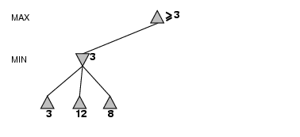
Alpha-beta pruning
The leaves below B have the values 3, 12 and 8.
The value of B is exactly 3.
It can be inferred that the value at the root is at least 3, because MAX has a choice worth 3.
B
31

Slide 32
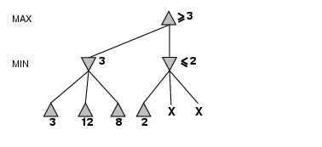
Alpha-beta pruning
C, which is a MIN node, has a value of at most 2.
But B is worth 3, so MAX would never choose C.
Therefore, there is no point in looking at the other successors of C.
B
C
32

Slide 33
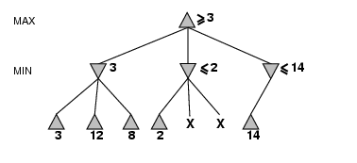
Alpha-beta pruning
D, which is a MIN node, is worth at most 14.
This is still higher than MAX’s best alternative (i.e., 3), so D’s other successors are explored.
B
C
D
33

Slide 34
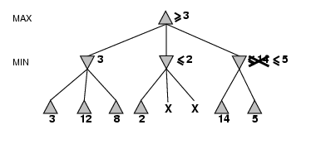
Alpha-beta pruning
The second successor of D is worth 5, so the exploration continues.
B
C
D
34

Slide 35
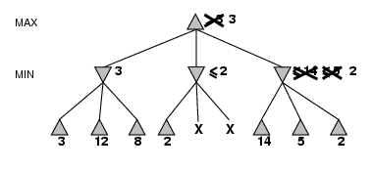
Alpha-beta pruning
The third successor is worth 2, so now D is worth exactly 2.
MAX’s decision at the root is to move to B, giving a value of 3
B
C
D
35

Slide 36
Alpha-beta pruning
Alpha-beta pruning gets its name from two parameters.
They describe bounds on the values that appear anywhere along the path under consideration:
α = the value of the best (i.e., highest value) choice found so far along the path for MAX
β = the value of the best (i.e., lowest value) choice found so far along the path for MIN
36

Slide 37
Alpha-beta pruning
Alpha-beta search updates the values of α and β as it goes along.
It prunes the remaining branches at a node (i.e., terminates the recursive call)
as soon as the value of the current node is known to be worse than the current α or β value for MAX or MIN, respectively.
37

Slide 38
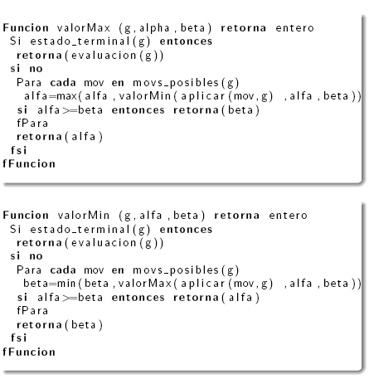
The alpha-beta search algorithm

Slide 39
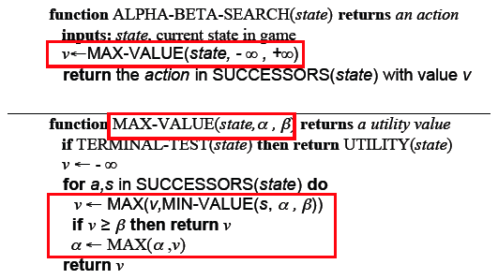
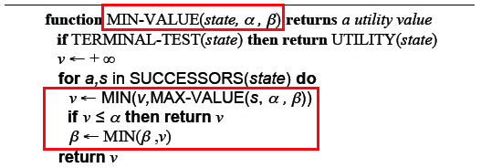
The alpha-beta search algorithm

Slide 40
Alpha-Beta Procedure
The alpha-beta procedure can speed up a depth-first minimax search.
Alpha: a lower bound on the value that a max node may ultimately be assigned
Beta: an upper bound on the value that a minimizing node may ultimately be assigned
v > α
v < β

Slide 41
Alpha-beta pruning
MAX
{α, β}
If V_{i} > α, modify α
If Vi ≥ β, β pruning
Return α
V_{i}
MIN
{α, β}
If V_{i} < β, modify β
If Vi ≤ α, α pruning
Return β
V_{i}
α and β bounds are transmitted from parent to child in the order of node visit. The effectiveness of pruning highly depends on the order in which successors are examined.

Slide 42
A
{alpha = -∞, beta = +∞}
A
{3, +∞}
{-∞, +∞}
{-∞, 3}
3
{-∞, 3}
{-∞, +∞}
B
C
B
C
D
E
D
E
3
3 5
A
{3, +∞}
The I subtree can be pruned, because I is a min node and the value of v(K) = 0 is < α = 3
3
B
C
{3, +∞}
{3, +∞}
D
F
G
H
{3, +∞}
I
J
K
L
0

Slide 43
A
{3, +∞}
A
{3, +∞}
B
C
{3, +∞}
3
B
C
{3, 5}
5
3
D
{3, +∞}
F
G
H
5
{3, 5}
D
F
G
H
J
5
4
5
J
M
7
N
A
B
C
4
3
The G subtree can be pruned, because G is a max node and the value of v(M) = 7 is > β = 5
5
D
F
H
4
5
J

Slide 44
Final comments about alpha-beta pruning
Pruning does not affect final results.
Entire subtrees can be pruned, not just leaves.
Good move ordering improves effectiveness of pruning.
With perfect ordering, time complexity is O(b^{m/2}).
Effective branching factor of sqrt(b)
Consequence: alpha-beta pruning can look twice as deep as minimax in the same amount of time.
44

